Slide 1
BITS Pilani
Department of Computer Science

Slide 2
Data Link Layer

Slide 3
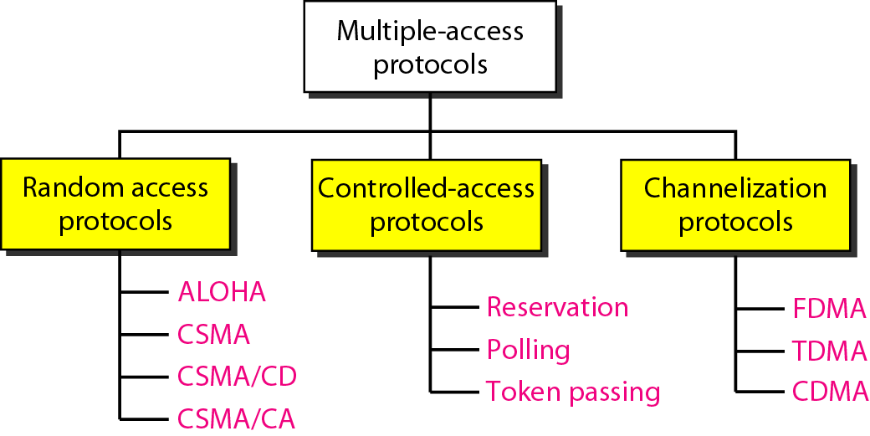
Multiple Access Mechanisms

Slide 4
Random Access Protocols
In random access or contention methods, no station is superior to another station and none is assigned then control over another. No station permits another station to send.
At each instance, a station that has data to send uses a procedure defined by the protocol to make a decision on whether or not to send.

Slide 5
Random Access Protocols
when node has packet to send
transmit at full channel data rate
not a priori coordination among nodes
>= 2 nodes transmit concurrently ➜ “collision”
random access MAC protocol specification
collision detection
collision recovery
types
Pure ALOHA, slotted ALOHA
CSMA, CSMA/CD, CSMA/CA

Slide 6
key ideas of random access
station model
n independent stations (nodes, terminals)
single channel
all transmission/reception on shared channel
nodes have equivalent ability
time
continuous
slotted (discrete, timed intervals, “master clock”)

Slide 7
key ideas of random access
carrier sense (or not)
listen before speaking, and don’t interrupt
check if someone else is already sending data ...
… wait till the other node is done
collision detection (or not)
if someone else starts talking at the same time, stop
if the data on the wire is garbled ...
... another node is transmitting, too, so stop
randomness
don’t start talking again right away
wait for a random time before trying again

Slide 8
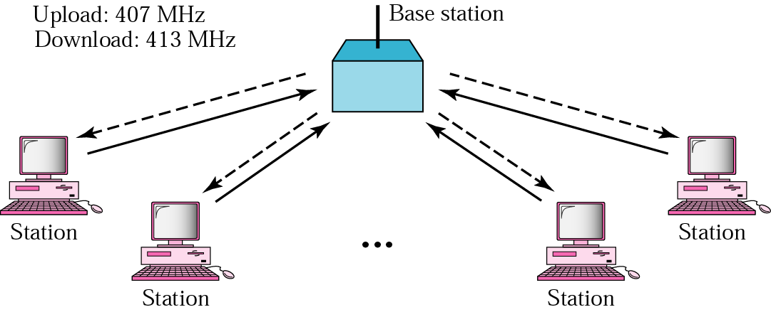
ALOHA Network

Slide 9
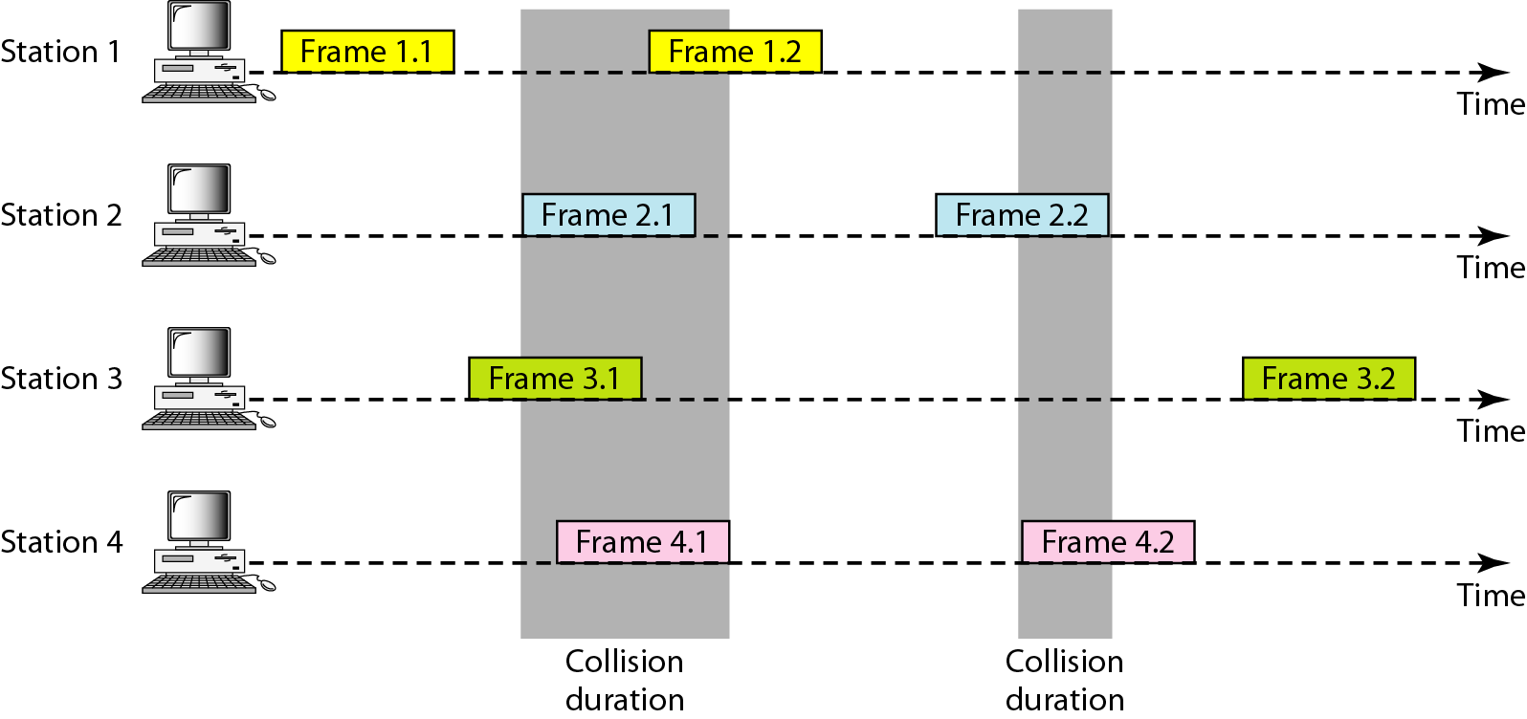
Frames in Pure ALOHA

Slide 10
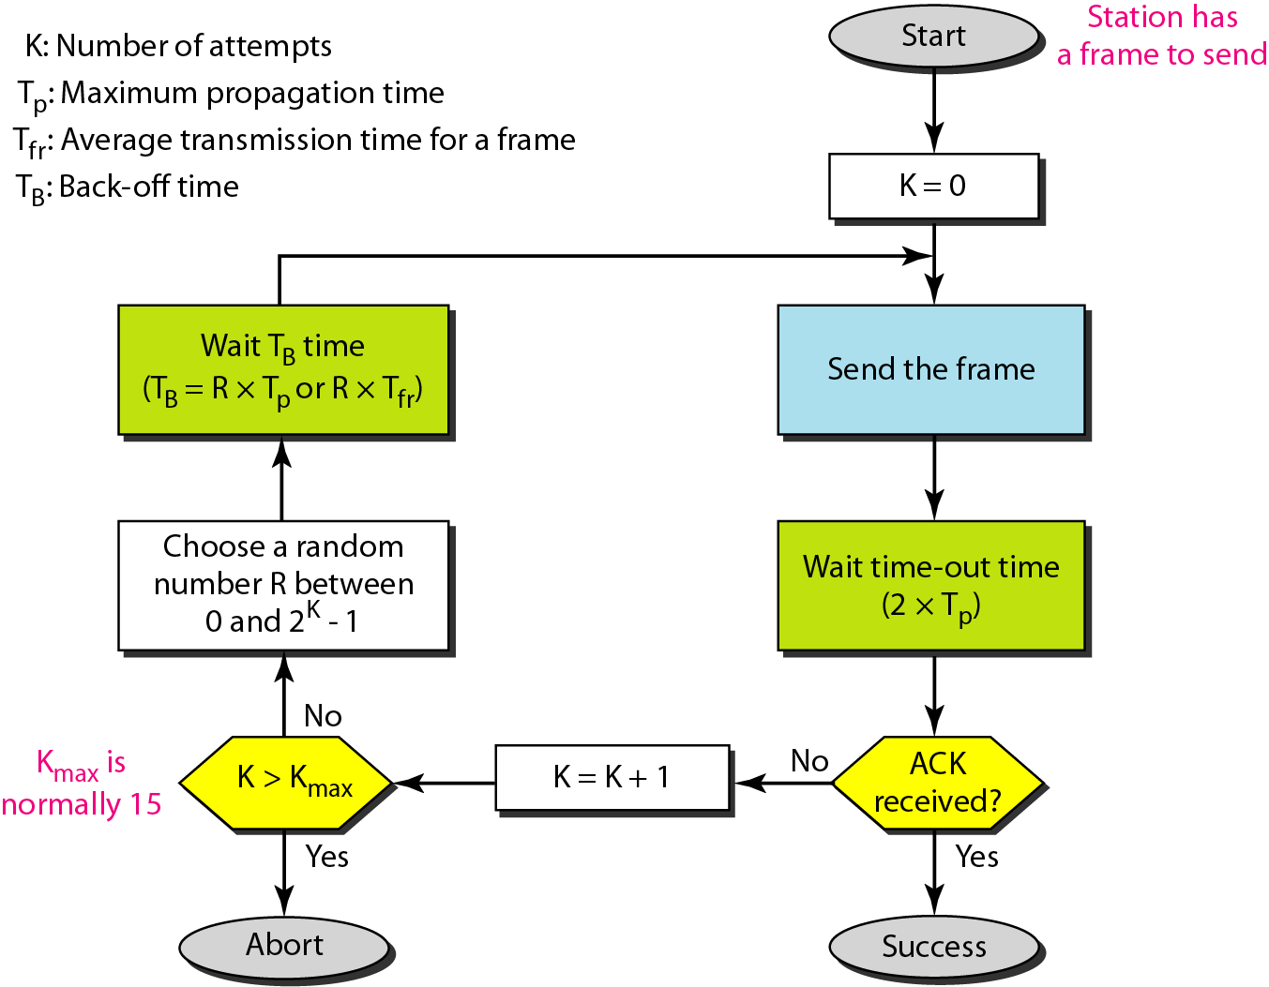
ALOHA Protocol

Slide 11
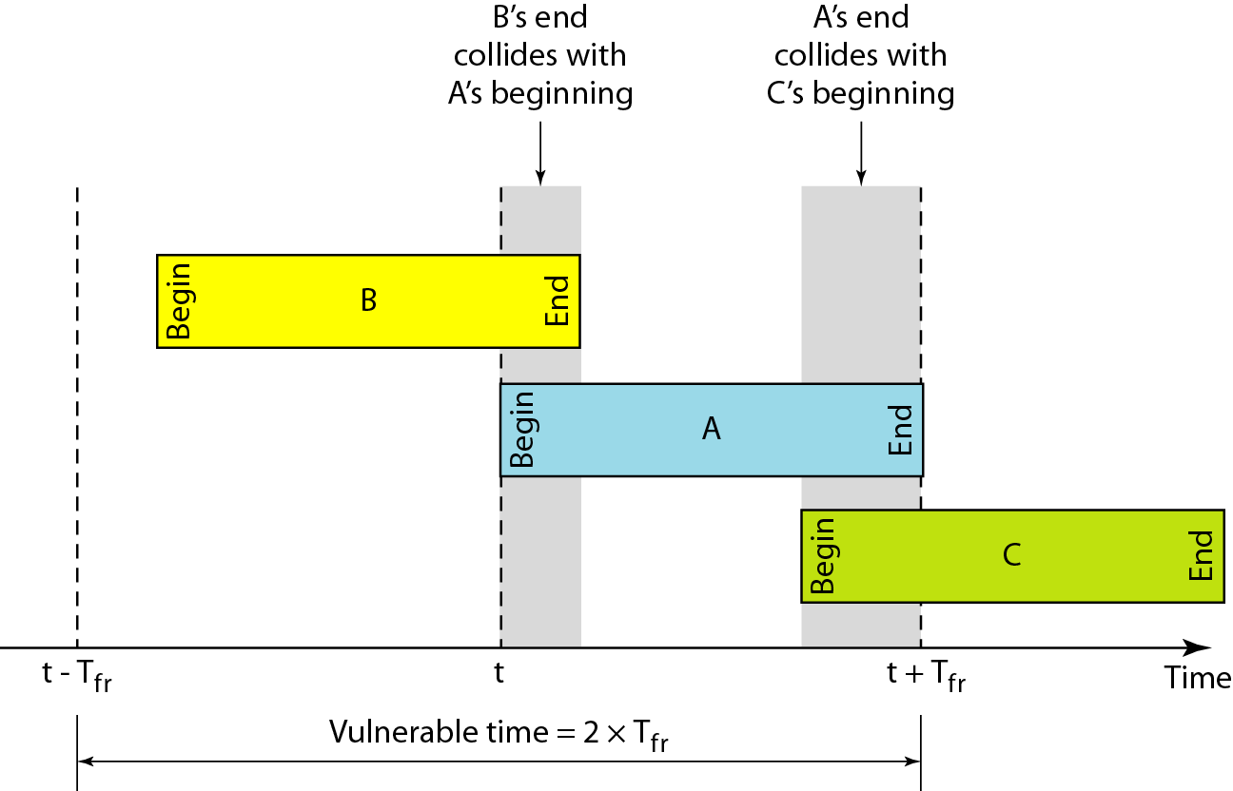
ALOHA: Vulnerable Time

Slide 12
ALOHA: Throughput
The number of packets successfully transmitted through the channel per packet time.
Assume number of stations trying to transmit follow Poisson Distribution
The throughput for pure ALOHA is
S = G × e^{−2G}
where G is the average number of frames requested per frame-time
The maximum throughput
S_{max} = 0.184 when G= 1/2

Slide 13
Slotted ALOHA
assumptions
all frames same size
time divided into equal slots (time to transmit a frame)
nodes start to transmit frames only at start of slots
nodes are synchronized
if two or more nodes transmit, all nodes detect collision
operation
when node obtains fresh frame, transmits in next slot
no collision: node can send new frame in next slot
collision: node retransmits frame in each subsequent slot with probability p until success

Slide 14
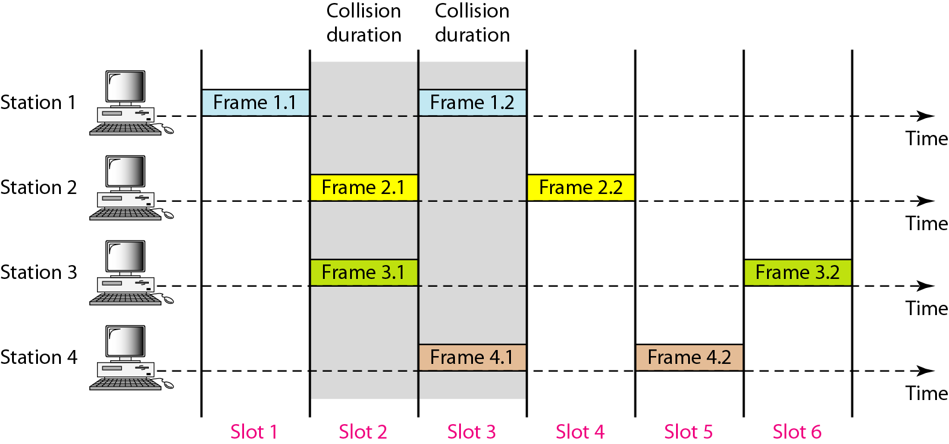
Slotted ALOHA

Slide 15
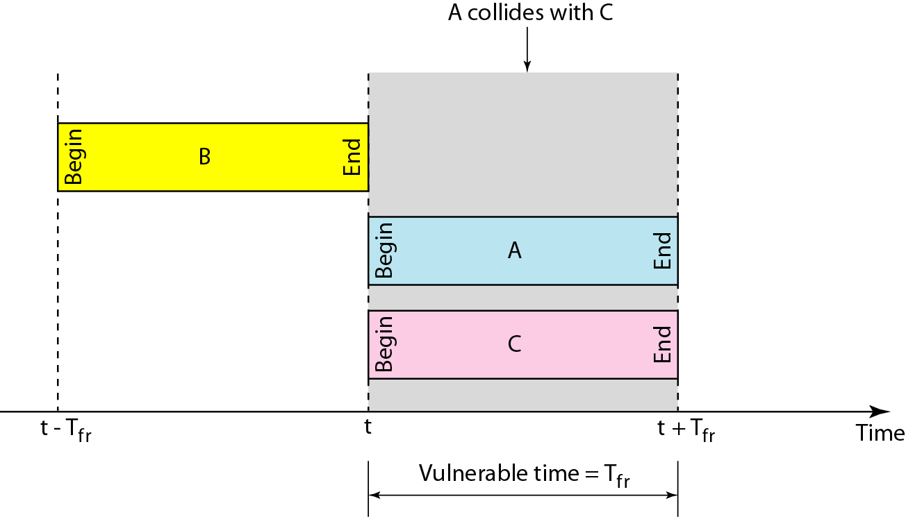
Slotted ALOHA: Vulnerable Time

Slide 16
Slotted ALOHA: Throughput
The throughput for Slotted ALOHA is
S = G × e^{−G}
where G is the average number of frames requested per frame-time
The maximum throughput
S_{max} = 0.368 when G= 1

Slide 17
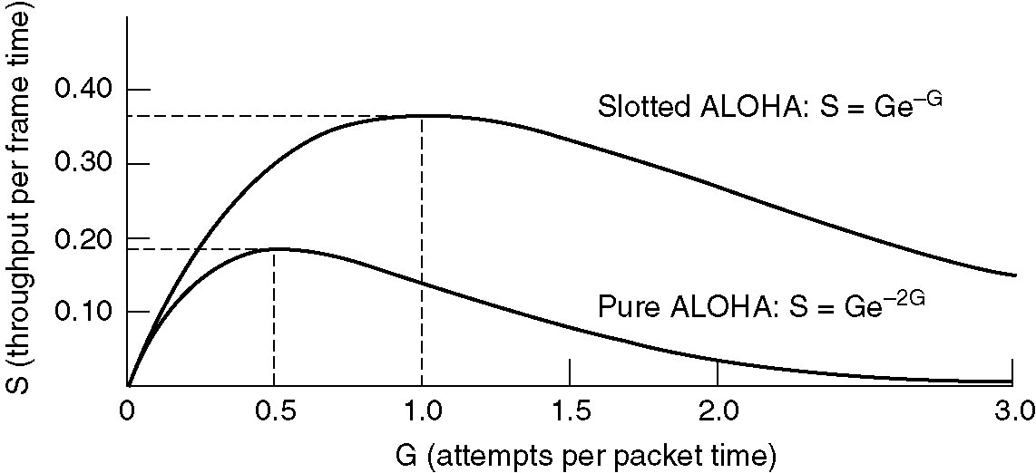
Pure vs. Slotted ALOHA
Throughput versus offered traffic for ALOHA systems.
max throughput: ALOHA 1/(2e) ~ 18%; slotted ALOHA 1/e ~ 37%

Slide 18
Carrier Sense Multiple Access (CSMA)
The capacity of ALOHA or slotted ALOHA is limited by the large vulnerability period of a packet.
By listening before transmitting, stations try to reduce the vulnerability period to one propagation delay.
This is the basis of CSMA (Kleinrock and Tobagi, UCLA, 1975)
Same assumptions made for ALOHA are made now for CSMA.

Slide 19
Carrier Sense Multiple Access (CSMA)
Invented to minimize collisions and increase the performance
A station now “follows” the activity of other stations
Simple rules for a polite human conversation
Listen before talking
If someone else begins talking at the same time as you, stop talking
CSMA:
A node should not send if another node is already sending → carrier sensing
CD (collision detection):
A node should stop transmission if there is interference → collision detection

Slide 20
Assumptions with CSMA Networks
1. Constant length packets
2. No errors, except those caused by collisions
3. Each host can sense the transmissions of all other hosts
4. The propagation delay is small compared to the transmission time

Slide 21
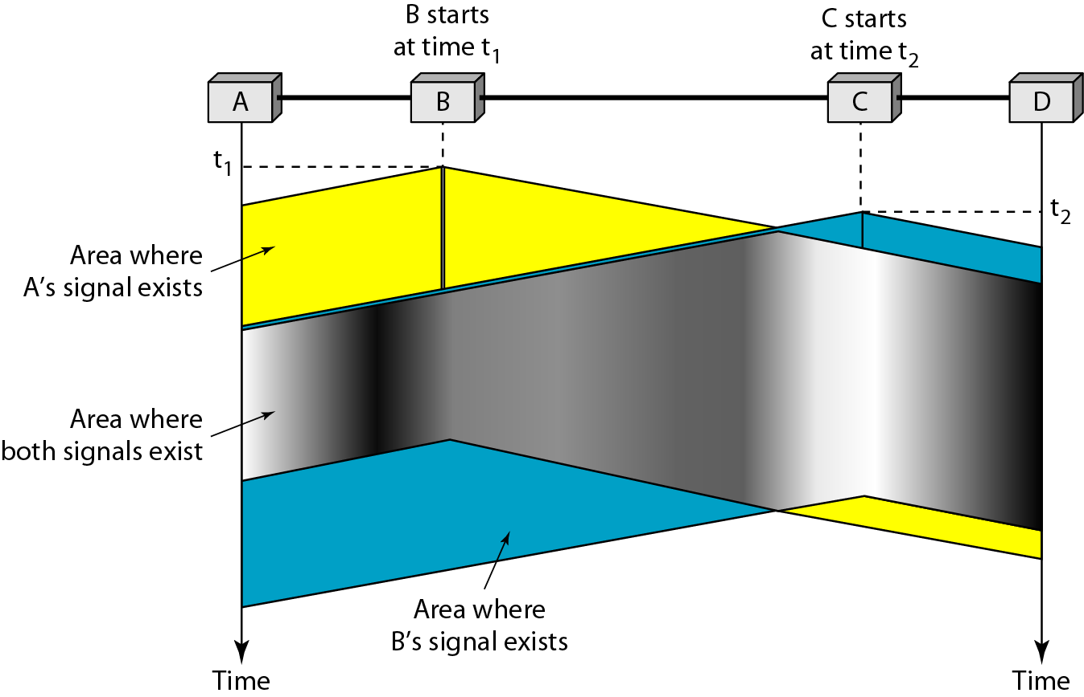
Collision in CSMA
B
C

Slide 22
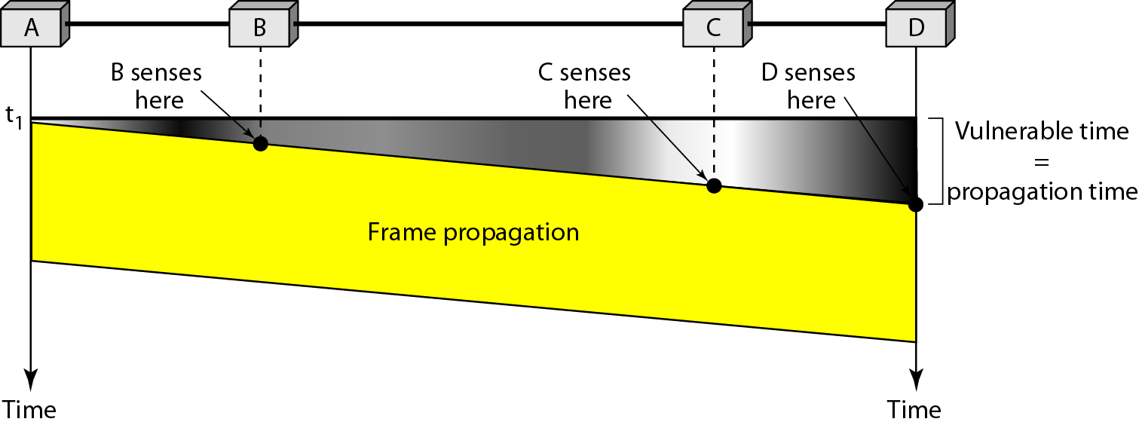
CSMA: Vulnerable Time

Slide 23
Persistence Methods
What a station does when channel is idle or busy
There are several types of CSMA protocols:
1-Persistent CSMA
Non-Persistent CSMA
P-Persistent CSMA

Slide 24
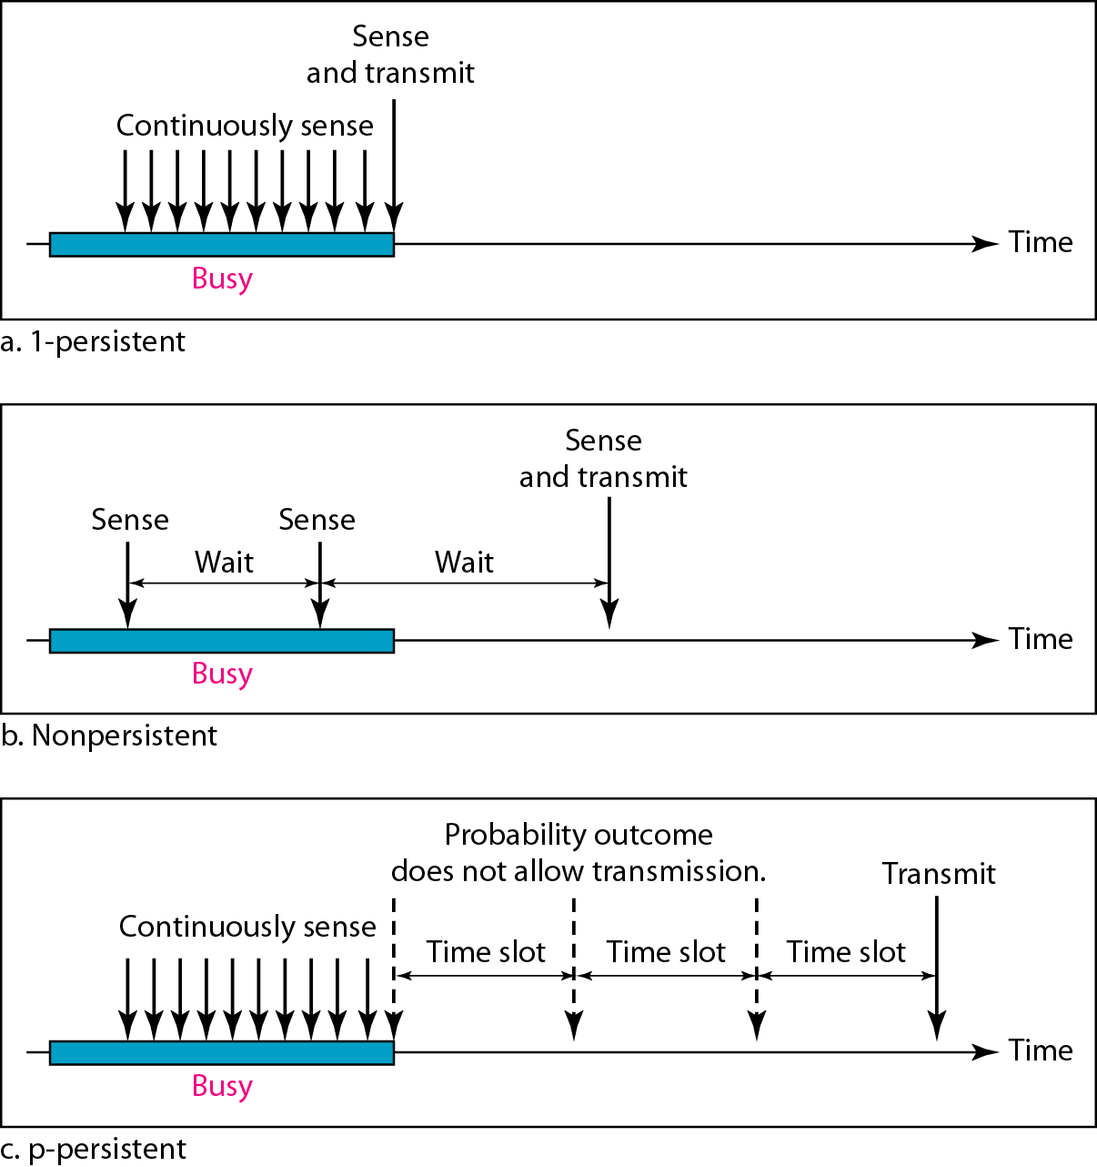
1-Persistence Methods
Sense the channel.
– If busy, keep listening to the channel and transmit immediately when the channel becomes idle.
– If idle, transmit a packet immediately.
If collision occurs,
– Wait a random amount of time and start over again.

Slide 25
Non-Persistence Methods
• Sense the channel.
– If busy, wait a random amount of time and sense the channel again
– If idle, transmit a packet immediately
If collision occurs
– wait a random amount of time and start all over again
Notes:
The protocol is called 1-persistent because
the host transmits with a probability of 1
whenever it finds the channel idle.

Slide 26
P-Persistence Methods
• Optimal strategy: use P-Persistent CSMA
• Assume channels are slotted
• One slot = contention period (i.e., one round trip propagation delay)
• This method is used when channel has time slots such that the time slot duration is equal to or greater than the maximum propagation delay time.
Notes:
The protocol is called 1-persistent because
the host transmits with a probability of 1
whenever it finds the channel idle.

Slide 27
P-Persistence Methods
• Whenever a station becomes ready to send, it senses the channel.
• If channel is busy, station waits until next slot.
• If channel is idle, it transmits with a probability p.
• With the probability q=l-p, the station then waits for the beginning of the next time slot.
• If the next slot is also idle, it either transmits or waits again with probabilities p and q.
• This process is repeated till either frame has been transmitted or another station has begun transmitting.
• In case of the transmission by another station, the station acts as though a collision has occurred and it waits a random amount of time and starts again.
Notes:
The protocol is called 1-persistent because
the host transmits with a probability of 1
whenever it finds the channel idle.

Slide 28
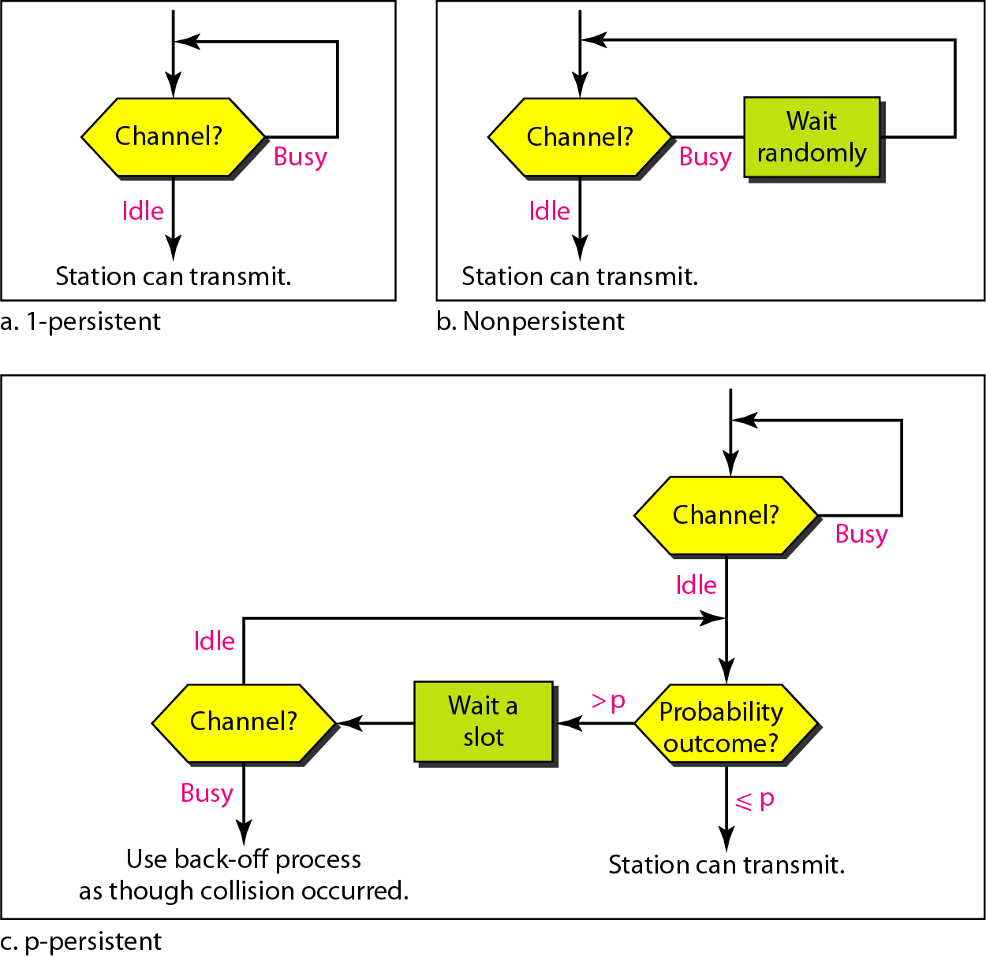
Persistence Methods

Slide 29
CSMA/CD Protocol
CSMA improves on the performance of ALOHA tremendously.
The remaining limitation is that, once a packet is sent, feedback occurs a roundtrip time after the entire packet is transmitted.
The solution to improve on the performance of CSMA is to listen to the channel while a packet is being sent.
This is called collision detection.

Slide 30
CSMA/CD Protocol
All hosts transmit & receive on one channel
Packets are of variable size.
When a host has a packet to transmit:
1. Carrier Sense: Check that the line is quiet before transmitting.
2. Collision Detection: Detect collision as soon as possible. If a collision is detected, stop transmitting; wait a random time, then return to step 1.
binary exponential backoff

Slide 31
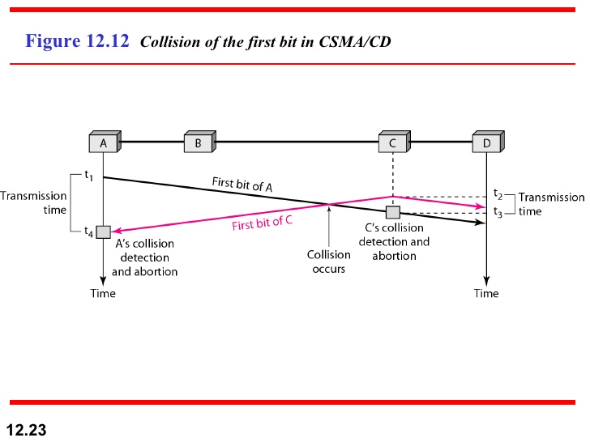

Slide 32
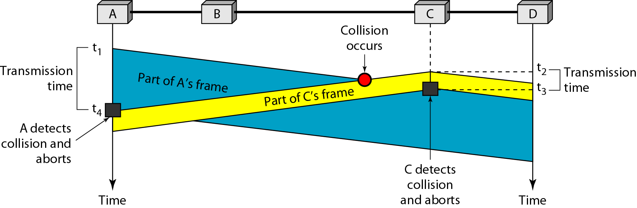
CSMA/CD

Slide 33
CSMA/CD Network Size Restriction
To ensure that a packet is transmitted without a collision, a host must be able to detect a collision before it finishes transmitting a packet.
A
“Line is idle”
“Line is idle”
B
t=PROP--
t=PROP-
t=0
t=PROP
t=2PROP-
PROP
PROP
Events:
t=0: Host A starts transmitting a packet.
t=PROP--: Just before the first bit reaches Host B, Host B senses the line to be idle and starts to transmit a packet.
t=PROP-: A collision takes place near Host B.
t=PROP: Host B receives data whilst transmitting, and so detects the collision. t=2PROP-: Host A receives data whilst transmitting, and so detects the collision.

Slide 34
CSMA/CD Network Size Restriction
“To ensure that a packet is transmitted without a collision, a host must be able to detect a collision before it finishes transmitting a packet.”

Slide 35
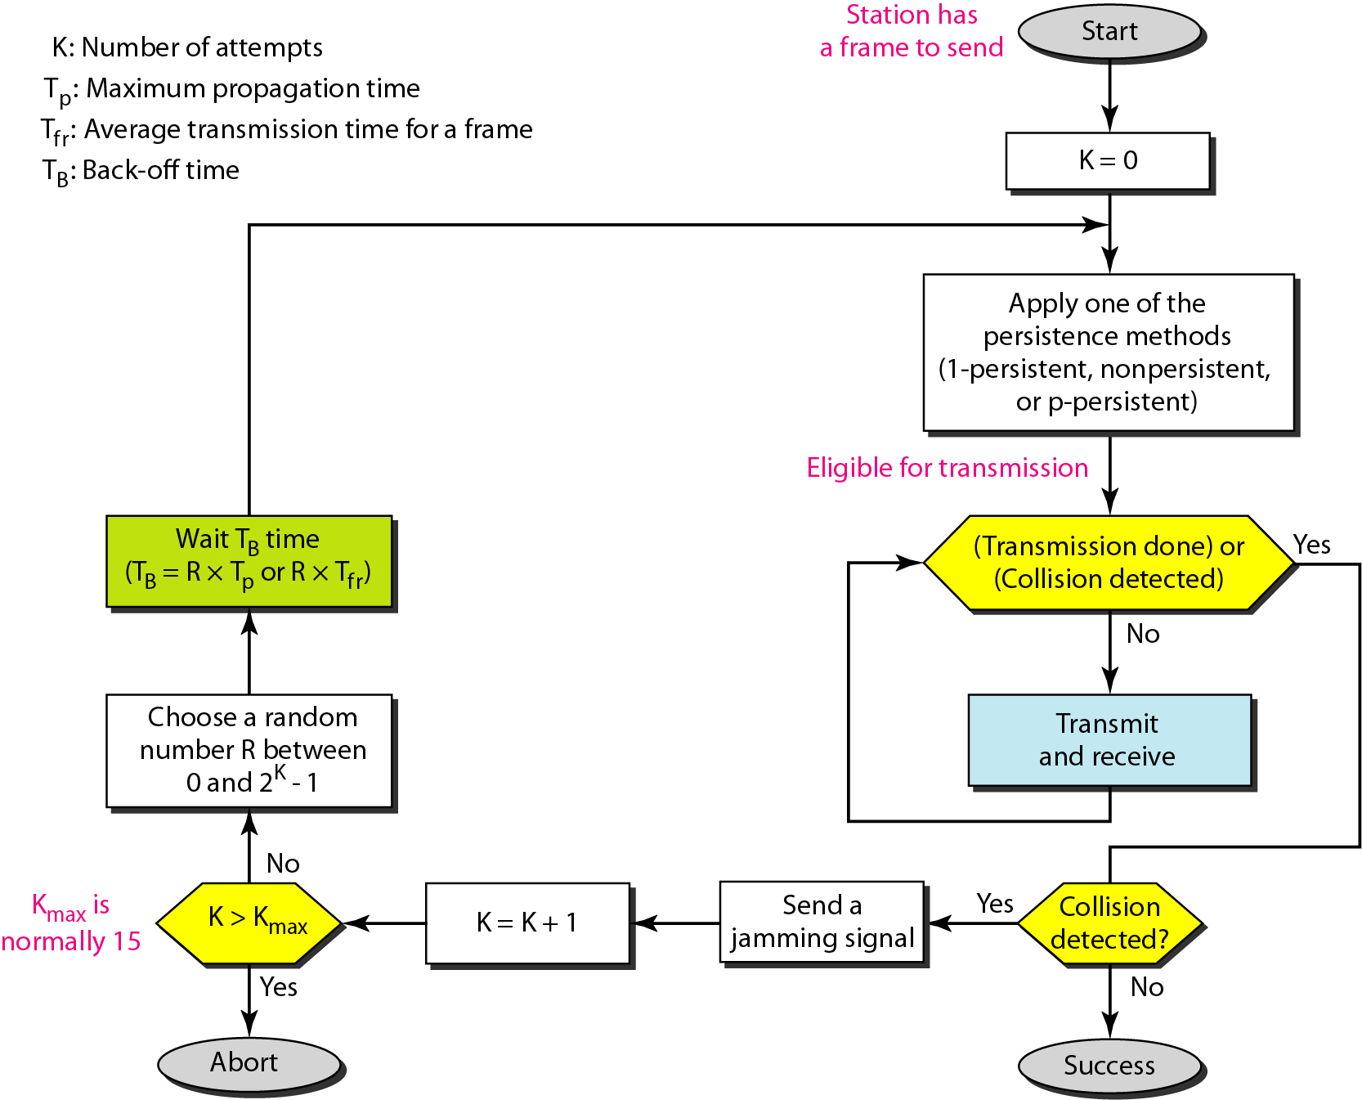
CSMA/CD: Flow Diagram

Slide 36
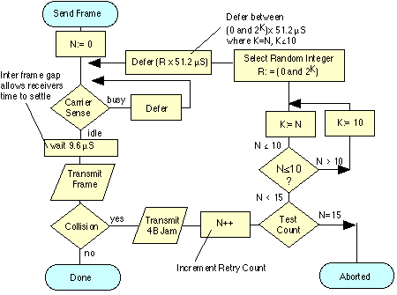

Slide 37
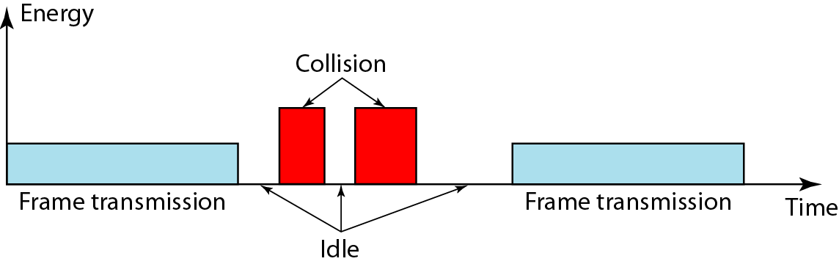
Energy Levels

Slide 38
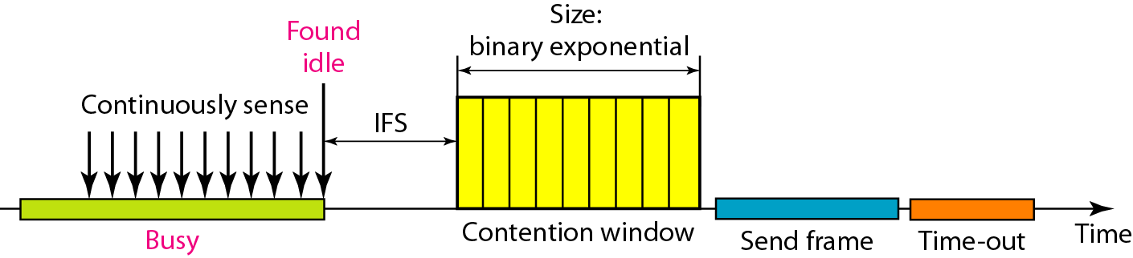
CSMA/CA
Energy level method may not suitable for wireless medium since the lost of energy in wireless transmission.
CSMA/CD is not possible in wireless.
CSMA/CA Used in a network where collision cannot be detected. E.g., wireless LAN.
IFS – Interframe Space

Slide 39
Distributed Coordination Function
DCF sublayer uses CSMA
if station has frame to send it listens to medium
if medium idle, station may transmit
else waits until current transmission complete
No collision detection since on wireless network
DCF includes delays that act as a priority scheme

Slide 40
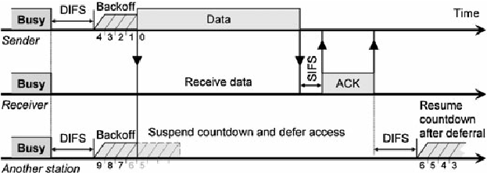
DCF Basic mode

Slide 41
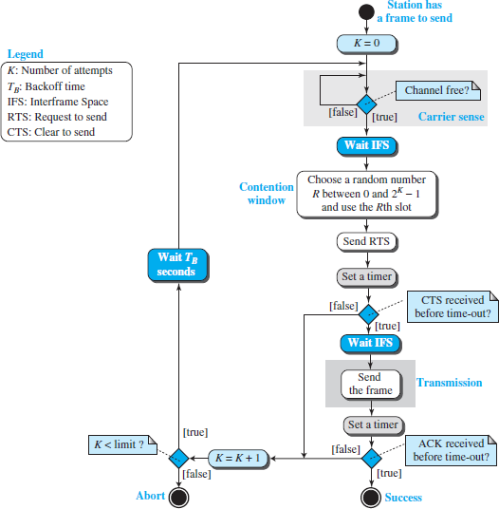
CSMA/CA: Flow Diagram

Slide 42
CSMA/CA
CSMA protocols sense the carrier, but sensing the carrier does not always releases true information about the status of the wireless channel
There are two problems that are unique to wireless channels (different than wireline channels), that makes CSMA useless in some cases. These problems are:
Hidden terminal problem
Exposed terminal problem.

Slide 43
Collision Avoidance Mechanisms
Problem:
Two nodes, hidden from each other, transmit complete frames to base station
Wasted bandwidth for long duration!
Solution:
Small reservation packets: RTS+CTS
Nodes track reservation interval with internal “network allocation vector” (NAV)

Slide 44
Hidden Terminal Problem
A’s cell
C’s cell
A
B
C
Hidden
terminal
A is transmitting to B.
C is sensing the carrier and detects that it is idle (It can not hear A’s transmission).
C also transmits and collision occurs at B.
A is hidden from C.

Slide 45
Exposed Terminal Problem
B’s cell
C’s cell
A
B
C
D
Exposed
terminal
B is transmitting to A. C is hearing this transmission.
C now wants to transmit to D. It senses the existence of carrier signal and
defers transmission to D.
However, C can actually start transmitting to D while B is transmitting to A,
Since A is out of range of C and C’s signals can not be heard at A.
C is exposed to B’s transmission.

Slide 46
Solution Concept
X, lets talk! I am available.
Y
Y, I want to talk to you!
Y, I want to talk to you!
X
Z

Slide 47
Multiple Access with Collision Avoidance (MACA) Protocol
When a station wants to transmit data
It sends an RTS (Ready-to-Send) packet to the intended receiver
The RTS packet contains the length of the data that needs to be transmitted
Any station other than the intended recipient hearing RTS defers transmission for a time duration equal to the end of the corresponding CTS reception
The receiver sends back CTS (Clear-to-Send) packet back to sender if it is available to receive.
The CTS packet contains the length of the data that original sender wants to transmit
Any station other than the original RTS sender, hearing CTS defers transmission until the data is sent.
The original sender upon reception of the CTS, starts transmitting.

Slide 48
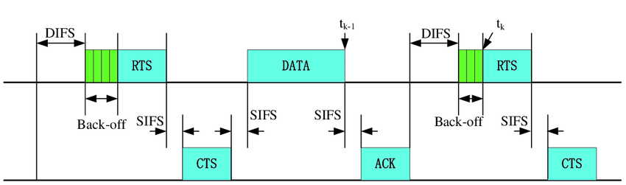
DCF + RTS/CTS

Slide 49
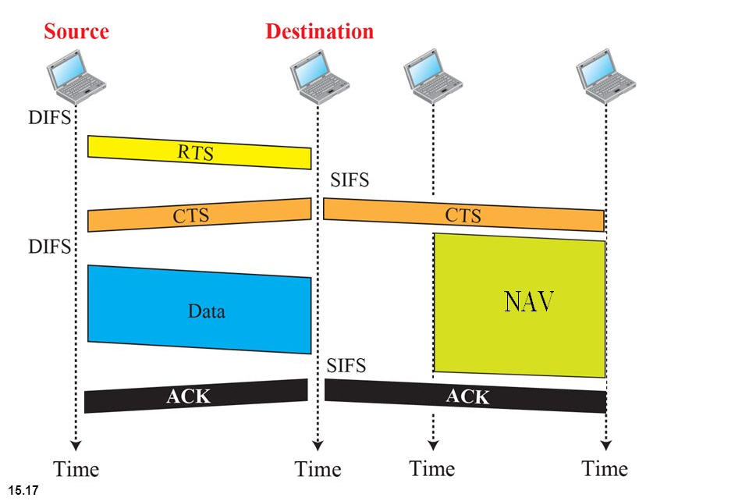
CSMA/CA and NAV
Distributed coordination function (DCF) Inter frame sequence (DIFS)
Short Inter frame sequence (SIFS)
Notes:
Distributed coordination function (DCF) Inter frame sequence (DIFS)

Slide 50
MACA Solution for Hidden Terminal Problem
A is transmitting to B.
A’s cell
C’s cell
RTS(n)
RTS(n)
CTS(n)
X
A
B
C
X defers transmission
until expected CTS
reception time by RTS
sender.
CTS(n)
C defers transmission
for duration of n bytes of
data transmission. Node A
is no longer hidden from C effectively.
Data(n)

Slide 51
MACA Solution for Exposed Terminal Problem
B is transmitting to A
B’s cell
C’s cell
A
RTS(n)
B
RTS(n)
C
D
CTS(n)
CTS
Data(n)
C defers transmission upon hearing B’s RTS until B could get CTS from A.
After that C can start transmission to D. For that it first sends an RTS.
C is not longer exposed to the data transmission of B.

Slide 52
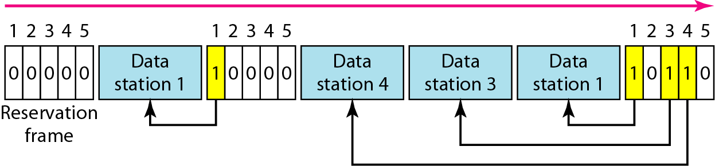
Reservation access method
Stations take turns transmitting a single frame at a full rate ( R ) bps
Transmissions are organized into variable length cycles
Each cycle begins with a reservation interval that consists of (N) minislots. One minislot for each of the N stations
When a station needs to send a data frame, it makes a reservation in its own minislot.
By listening to the reservation interval, every station knows which stations will transfer frames, and in which order.
The stations that made reservations can send their data frames after the reservation frame.

Slide 53
Polling
Stations take turns accessing the medium
Two models: Centralized and distributed polling
Centralized polling
One device is assigned as primary station and the others as secondary stations
All data exchanges are done through the primary
When the primary has a frame to send it sends a select frame that includes the address of the intended secondary
When the primary is ready to receive data it send a Poll frame for each device to ask if it has data to send or not. If yes, data will be transmitted otherwise NAK is sent.
Polling can be done in order (Round-Robin) or based on predetermined order
Distributed polling
No primary and secondary
Stations have a known polling order list which is made based on some protocol
station with the highest priority will have the access right first, then it passes the access right to the next station (it will send a pulling message to the next station in the pulling list), which will passes the access right to the following next station, …

Slide 54
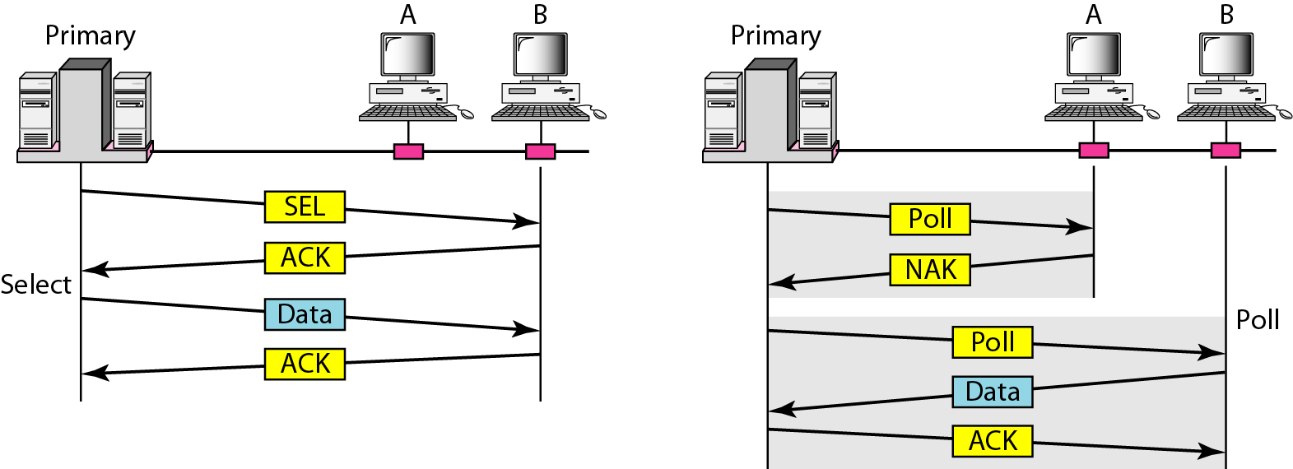
Select and poll functions in polling access method
Primary is sending to Secondary
Secondary is sending to Primary

Slide 55
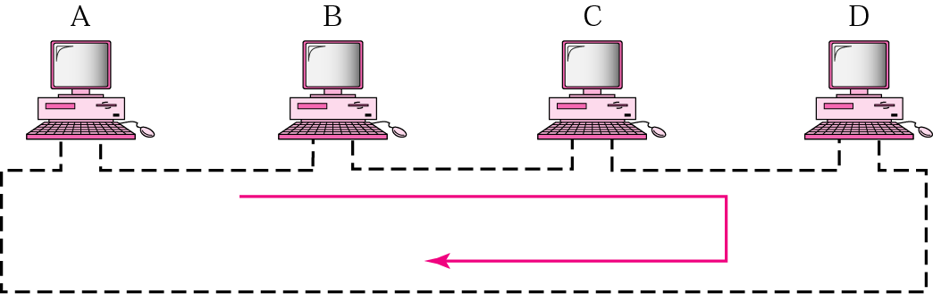
Token-Passing network
Implements Distributed Polling System
bits are copied to the output bits with a one bit delay
Bits are inserted by the station
listen mode
transmit mode
input
from
ring
1 bit delay
output
to
ring
delay
to station
from station
to station
from station
Station Interface is in two states:
Listen state: Listen to the arriving bits and check the destination address to see if it is its own address. If yes the frame is copied to the station otherwise it is passed through the output port to the next station.
Transmit state: station captures a special frame called free token and transmits its frames. Sending station is responsible for reinserting the free token into the ring medium and for removing the transmitted frame from the medium.

Slide 56
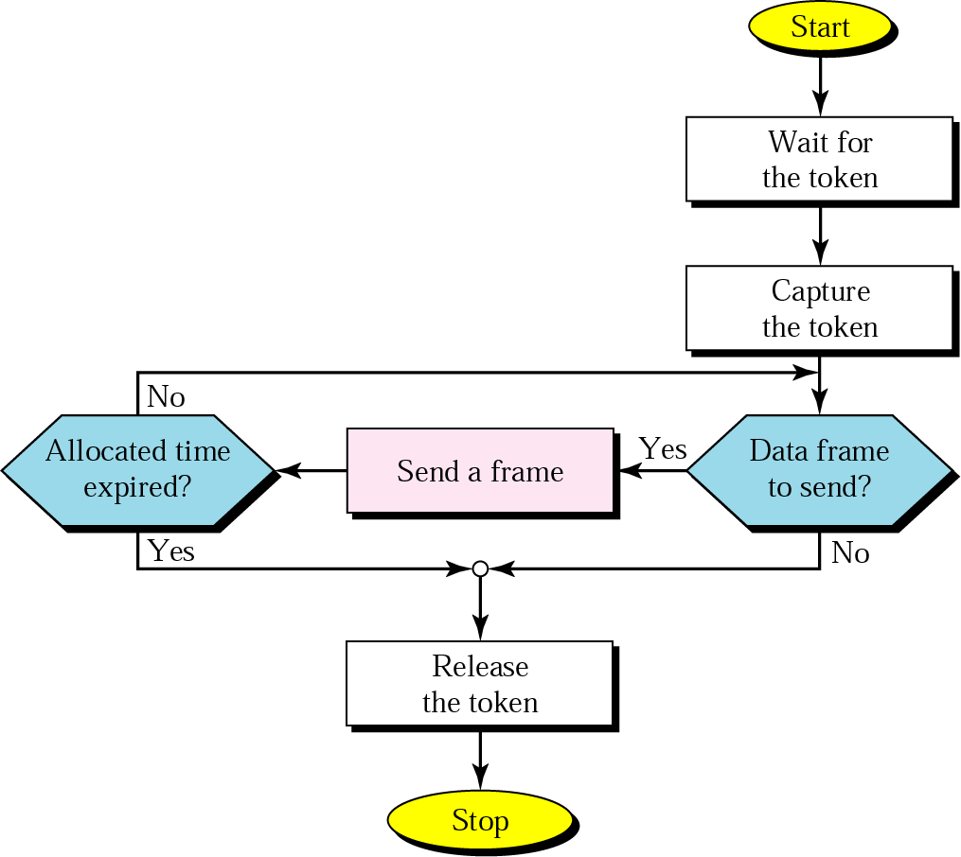
Token-passing procedure

Slide 57
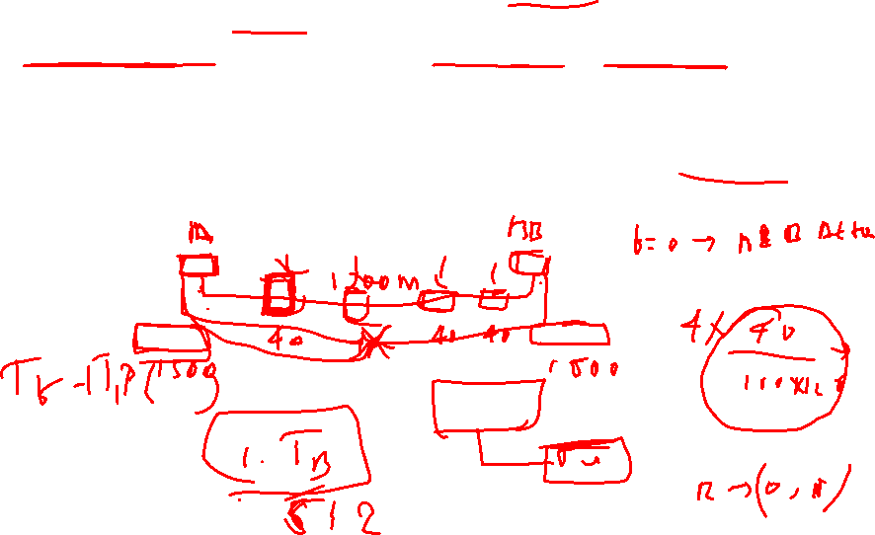

Slide 58
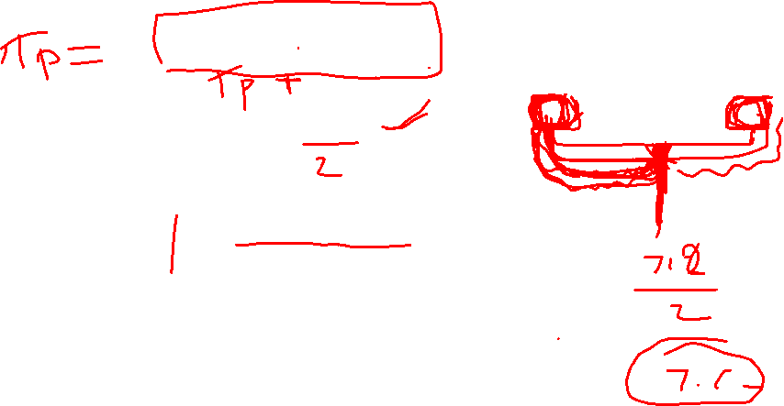

Slide 59
Suppose nodes A and B are on the same 10Mbps Ethernet segment and them propagation delay between the two nodes is 225 bit times. Suppose A and B send frames at the same time, the frames collide, and then A and B choose different values of K in the CSMA/CD algorithm. Assuming no other nodes are active, can the retransmissions from A and B collide? For our purposes, it suffices to work out the following example. Suppose A and B begin transmission at t=0 bit times. They both detect collisions at t=225 bit times. They finish transmitting a jam signal at t=225+48=273 bit times Suppose K_a=0 and K_b=1. At what time does B schedule its retransmission? At what time does A begin transmission?

